Slide 1
Micro Services
WITH SERVICE DISCOVERY AND LOAD BALANCER

Slide 2
INSTALLATION
Service Discovery : Consul
https://www.consul.io/downloads.html
Load Balancer : Fabio
https://github.com/fabiolb/fabio/releases

Slide 3
SART CONSUL & FABIO
Start Consul
consul agent -dev
http://localhost:8500/ui
Start Fabio
fabio
http://localhost:9998/routes

Slide 4
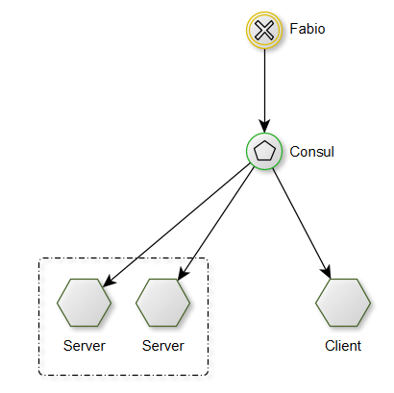
START SERVICES
Start Services
server: port: 8080 spring: application: name: server cloud: consul: host: localhost port: 8500 discovery: tags: "urlprefix-/server/test strip=/server" # to define route enabled: true instanceId: ${spring.application.name}-${server.port} healthCheckPath: /health healthCheckInterval: 5ms
<dependency> <groupId>org.springframework.cloud</groupId> <artifactId>spring-cloud-starter-consul-discovery</artifactId> </dependency>

Slide 5
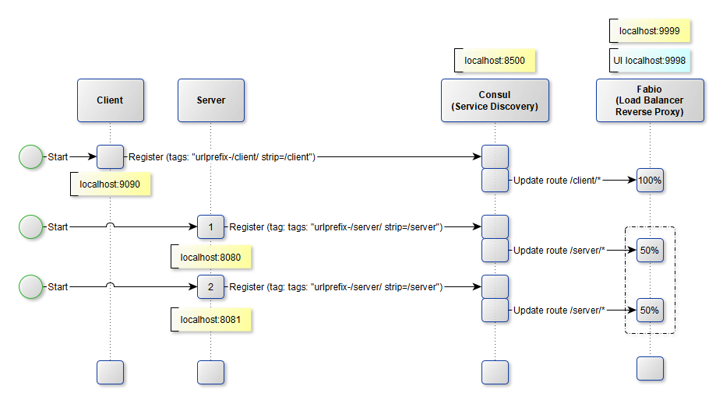
STARTING SEQUENCE

Slide 6
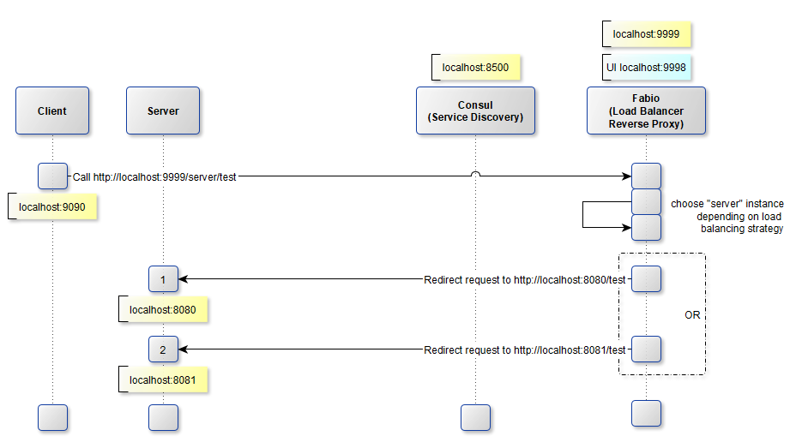
CALLING SEQUENCE

